Slide 1
BANGLADESH MS FARHANA Afroz Senior ASSISTANT professor dept. of Social Science aiub

Slide 2
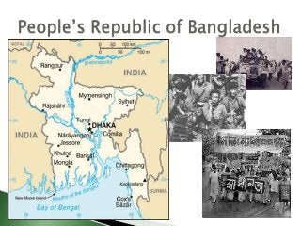

Slide 3
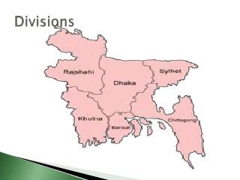
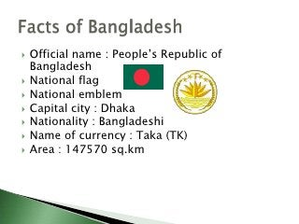
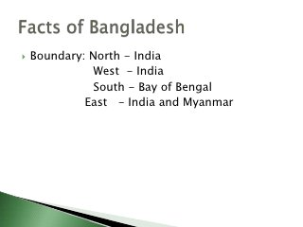
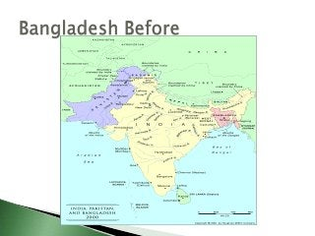

Slide 5
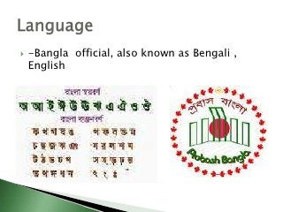
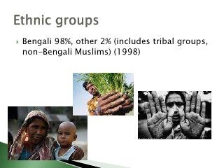

Slide 6
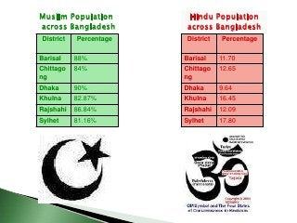
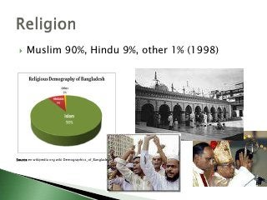

Slide 7
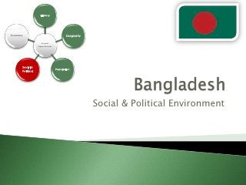
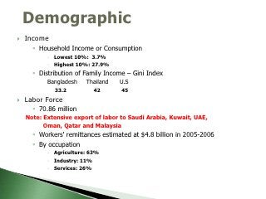

Slide 8
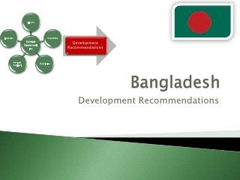
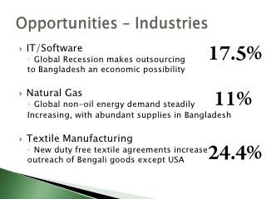

Slide 9
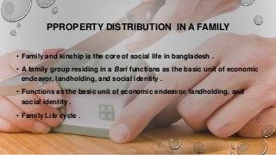
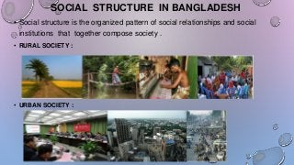

Slide 10

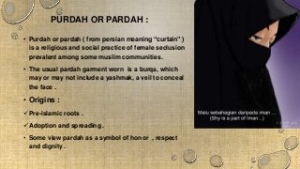

Slide 11
Defining Culture
The Elements of Culture
Cultural Diversity
Popular Culture
Theoretical Perspectives on Culture
Cultural Change

Slide 12
Defining Culture:
Complex system of meaning and behavior that defines the way of life for a society.
Includes beliefs, values, knowledge, art, morals, laws, customs, habits, language, and dress.

Slide 13
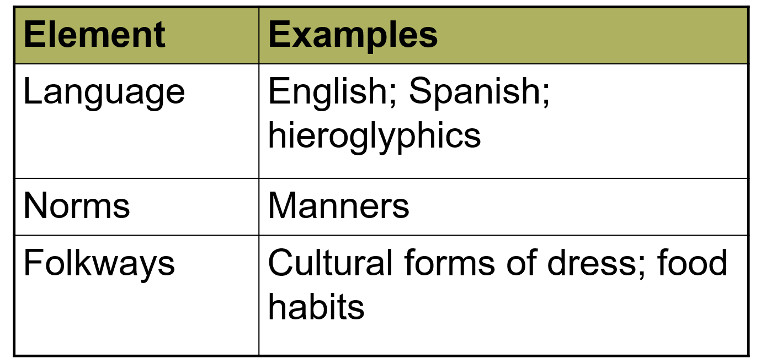

Slide 14
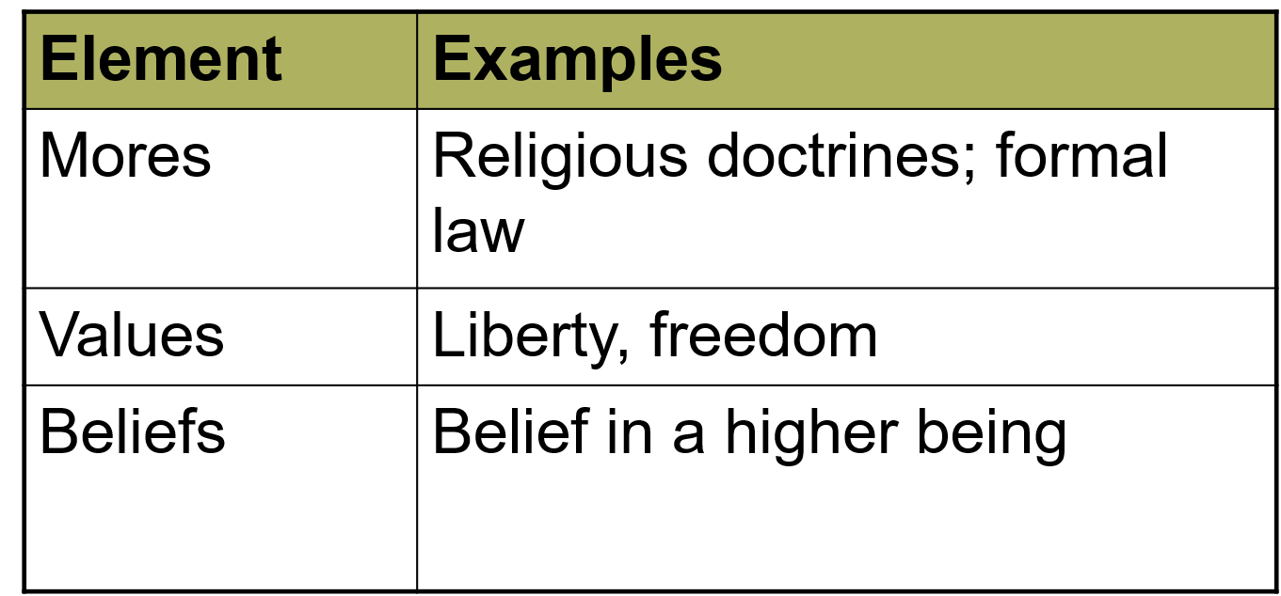

Slide 15
NORMS:
Specific cultural expectations for how to behave in a given situation.
A society without norms would be in chaos; with established norms, people know how to act, and social interactions are consistent, predictable, and learnable.
Social sanctions are mechanisms of social control that enforce norms.

Slide 16
Beliefs:
Shared ideas people hold collectively within a culture.
Beliefs are the basis for many of a culture’s norms and values.
Beliefs orient people to the world by providing answers to otherwise imponderable questions about the meaning of life.

Slide 17
Values:
Abstract standards in a society or group define the ideal principles of what is desirable and morally correct.
Values determine what is considered right and wrong, beautiful and ugly, good and bad.
Values can provide rules for behavior, but can also be the source of conflict.

Slide 18
Dominant Culture:
The dominant culture is the most powerful group in society.
It receives the most support from major institutions and constitutes the major belief system.
Social institutions in the society perpetuate the dominant culture and give it a degree of legitimacy that is not shared by other cultures.

Slide 19
SUB-CULTURE:
The cultures of groups whose values and norms of behavior differ from the dominant culture.
Members of subcultures interact frequently and share a common worldview.
Subcultures share some elements of the dominant culture and coexist within it.

Slide 20
COUNTER CULTURE:
Subcultures are created as a reaction against the values of the dominant culture.
Members of the counterculture reject the dominant cultural values and develop cultural practices that defy the norms and values of the dominant group.
Nonconformity to the dominant culture is often the mark of a counterculture.

Slide 21
ETHNOCENTRISM:
Judging a culture by standards of one’s own culture:
Builds group solidarity
discourages understanding
can lead to conflict, war, and genocide

Slide 22
POPULAR CULTURE:
The beliefs, practices, and objects are part of everyday traditions.
It is mass-produced and mass-consumed.
Has enormous significance in the formation of public attitudes and values, and plays a significant role in shaping the patterns of consumption in contemporary society.

Slide 23
SOURCES OF CULTURAL CHANGES:
A change in societal conditions.
Cultural diffusion
Innovation
Imposition of cultural change by an outside agency.

Slide 24
Defining the Family
Diversity Among Contemporary American Families
Marriage and Divorce
Changing Families, Changing Society

Slide 25
Bangladeshi Food:
Description: Bangladesh is most natural beautiful country in the world. There are many kinds of reason that are famous for the Bangladesh. Bangladeshi food are most delicious food and some are most special food items.
In the day there are 3 part are divided by taking meal that are in the morning Breakfast, Midday Meal and Night meal. Breakfast meals are taken bread, Rice,egg and others.
In the midday all Bangladeshi people are like to eat Fish, Meat,Dal and the Rice is common in every taking meal. In the Night meal are always take the same in the Midday meal.

Slide 26
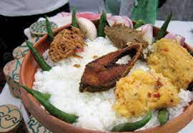

Slide 27
Number of Marriage Partners
Polygamy is the practice of men or women having multiple marriage partners.
Polygamy usually involves polygyny, one man having more than one wife.
Polyandry is the practice of a woman having more than one husband.
Monogamy is a sexually exclusive marriage with one spouse.

Slide 28
Who Marries Whom?
Exogamy is the practice of selecting mates from outside one’s group.
Endogamy is the practice of selecting mates from within one’s group.
The group may be based on religion, territory, racial identity, and so forth.
The incest taboo, considered to be universal, is a cultural norm forbidding sexual relations and marriage between certain kin.

Slide 29
Property and Descent
Kinship systems shape the distribution of property in society by prescribing how lines of descent are determined.
In patrilineal kinship systems, family lineage is traced through the family of the father.
Matrilineal kinship systems are those in which ancestry is traced through the mother.
In bilateral kinship systems, descent is traced both through the father and the mother.

Slide 30
Place of Residence
In the United States, newly married couples are expected to establish independent households.
In patrilocal kinship systems, after marriage, a woman is separated from her own kinship group and resides with the husband or his kinship group.
In matrilocal kinship systems, a woman continues to live with her family of origin.
The neolocal residence is the practice of the new couple establishing their own residence.

Slide 31
Who Holds Power?
Marriage systems vary according to who holds power in the marriage.
Patriarchy is a society or group where men have power over women.
In a matriarchy women hold power.
In egalitarian societies men and women share power equally, are equally valued by all societal members, have equal access to resources, and share decision-making.

Slide 32
Extended and Nuclear Families
Extended families are the whole network of parents, children, and other relatives who form a family unit.
Extended families are common among the urban poor because they develop a cooperative system of social and economic support.
The nuclear family is comprised of one married couple residing together with their children.

Slide 33
Factors in Rising Divorce Rate
In earlier eras, people died younger, and the average length of marriages was shorter.
The cultural orientation toward individualism may predispose people to terminate a marriage in which they are unhappy.

Slide 34
Factors in Rising Divorce Rate
To people in unhappy marriages, divorce, though painful and financially risky, can be a positive option.
The belief that couples should stay together for their children is giving way to a belief that a marriage with protracted conflict is more detrimental than divorce.

Slide 35
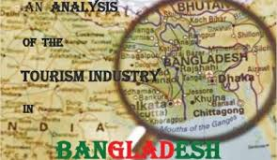

Slide 36
MAJOR TOURISTS PLACE IN BANGLADESH:
Jaflong, Ratargul, Srimongal, Cox’s Bazar, Lalmai, Moinamoti and Shalbon bihar, Rangamati, Ahsan Manjil, Sundarban, Kuakata.

Slide 37
Importance of tourism
Tourism is an important driver of economic growth. Besides this, people have an opportunity to exchange cultures. Tourism can earn a huge amount of foreign currency. Tourism can support the Balance of payment (BOP) of a country. Tourism can create employment.

Slide 38
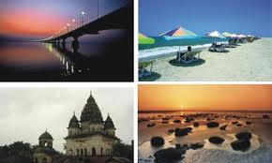
IMPACT OF TOURISM:
There are economic, social
Cultural land environmental key
benefits of tourism.
1/Economic Benefits
2/Social Benefits
3/Environmental Benefits

Slide 39
Objectives of tourism policy
To contrast various rules under the law where the main objective is to fill in the gap of existing tourism rules.
To develop tourism industries through various planning-related activities.
To create general awareness regarding tourism protection, development and exploration
To execute responsible tourism through the creation of some helping hand on behalf of government like as personal sector, local sector, local administration, NGO, women federation and media.
To create a strong and safe foothold for the Bangladeshi tourist
To create a tourism-friendly environment in Bangladesh.
To develop human resources for the tourism sector.

Slide 40
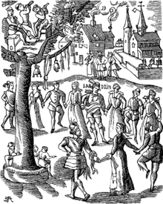
WHAT IS FESTIVALS?
A festival is an event ordinarily celebrated by a community and centering on some characteristic aspect of that community and its religion or culture. It is often marked as a local or national holiday, such as mela, or Eid. A festival constitutes a typical case of globalization, as well as the high culture-low culture interrelationship. Food is such a vital resource that many festivals are associated with harvest time.

Slide 41
MEJOR FESTIVALS IN BANGLADESH
Bangladesh is a land of festivals. There is a popular saying in Bangla ‘Baro Mashe Tero Paban’ meaning 13 festivals in 12 months. It is interesting to note that many of our festivals are linked to religions, seasons and specials occasions. In recent times, international festivals have also been added to the list. However, festivals can be grouped broadly into religious, nonreligious, indigenous and nonindigenous.
Festivals are common to all societies and cultures. With the change of social and economic structures, the natures of festivals also change. But some festivals are so deeply rooted in the social organism that they continue to entertain from generation to generation. The festivals, which got started in the primitive society centering on the prayer for food, have now been filled with various colors and varieties.

Slide 42
MAJOR FESTIVALS:
POHELA BOISHAKH
POHELA FALGUN
LALON MELA
THE KITE FLYING FESTIVAL
INDEPENDENCE DAY
WORLD MOTHER LANGUAGE DAY
NABANNA
Ekushey Boi Mela:
Dhaka International Trade Fair:
Eid Ul Fitr
Eid Ul Adha
MUHARRAM
CHIRSTMAS
DURGA PUJA

Slide 43
POHELA BOISHAKH
The first day of Bangla year is celebrated as Pohela Boishakh. The day is celebrated with festivity across the country. It is celebrated in villages and towns. People in the village celebrate this day according to their age-old customs. Special meals are arranged at home.
Baisakhi melas are held in different places. In towns, various socio-cultural organizations arrange interesting programs on this day. At Ramna Batamul, it is celebrated gorgeously. Many urban people wake up early in the morning and go to the function to enjoy poem reciting, songs, stage drama, lecture, etc.
Many people eat panta hilisa in the morning. Children put on colorful dresses. They go to the Boishakhi Mela and buy sweets, toys, dolls, and handmade things. They enjoy the day with great pleasure.

Slide 44
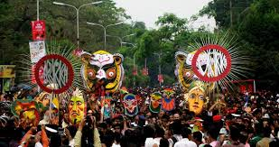
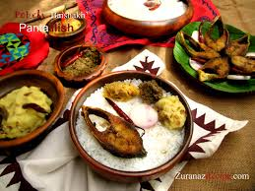
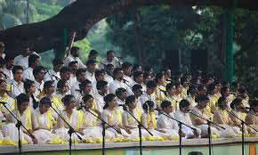

Slide 45

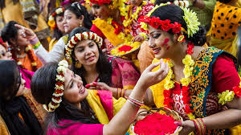
POHELA FALGUN
Bangladesh is a country where colorful fairs and festivals. In Bangladesh, the spring season stays for two months [Falgun and Chaitra]. A colorful festival was held to welcome Bashanto. Attired in reddish-yellow saris with red border and hairs decorated with flowers, young women and girls as well as young men and boys in traditional pajama and Punjabi, carrying flowers, took part in the colorful march. A good number of kids also got their attractive faces painted with different motifs including birds, the national flag, butterflies etc. Pahela Falgun is celebrated on February 13. It is called the ‘Rituraj Bashonto’.

Slide 46
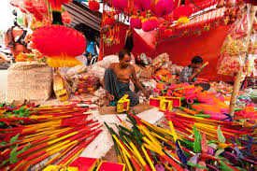
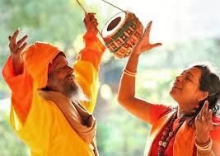
LALON MELA
Lalon song is called the song of a spiritual anthem. Every year, a five-day long fair is organized at Kushtia on the eve of Baul Fakir Lalon Shah’s birth anniversary otherwise known as ‘Tirodhn Dibosh.’ The akhara (a place where Lalon lived) is colorfully decorated where thousands of Lalon devotees gather from different locations of the country to celebrate his philosophical thoughts by performing his thousands of compositions.

Slide 47
THE KITE FLYING FESTIVAL
In Bangladesh, each season has its individual way of representing nature here. All over the country, the Kite Flying Festival also known as the Shakrain Festival takes place to celebrate spring (Bashanta). The clear blue sky gets packed with high-flying kites in different colors and shapes

Slide 48
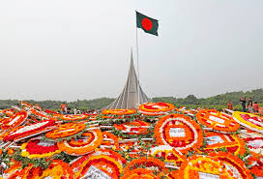
INDEPENDENCE DAY
The biggest state festival, the Independence day (March 26) is observed throughout the country. All major cities wear a festive look. It is a public holiday. The citizens of Dhaka wake up early in the morning to the sound of booming guns heralding the day. Leaders of the government, political and social organizations, freedom fighters and ordinary citizens alike place floral wreaths at the National Martyrs' Memorial at Savar.

Slide 49
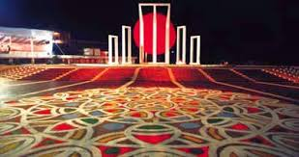
WORLD MOTHER LANGUAGE DAY
21 February of every year is observed throughout the country in remembrance of the martyrs' of the Language Movement of 1952. Blood was shed on this day in the Central Shahid Minar area to establish Bangla as a state language of Pakistan. On this day, everybody holds a black badge and walk to the Shaheed Minar barefooted. They go there to offer flowers on the altar of the Shaheed Minar to show respect to the martyrs.

Slide 50
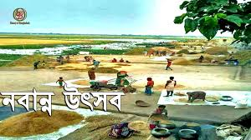
NABANNA
Navanna [nava + anna] literally, new food] a harvest festival celebrating the harvesting the new crop- aman paddy. Most agricultural societies tend to celebrate the harvesting of their main crop.

Slide 51
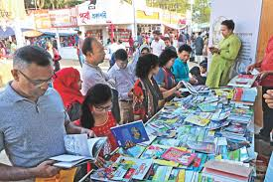
Ekushey Book Fair
Ekushey Book Fair is now a popular festival in the life of people. It is held only once in a year. Ekushey Book Fair or Amor Ekushey Grontho Mela (“Book Fair of the Immortal 21st"), commonly known as Ekushey Boi Mela (“Book Fair of the 21st"), is the national book fair of Bangladesh. It takes place over the entire month of February every year,

Slide 52
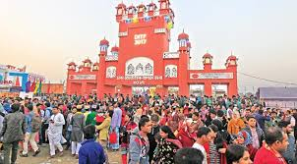
Dhaka International Trade Fair
Dhaka International Trade Fair is an international trade fair in Bangladesh. It is organized by the Export Promotion Bureau together with the Ministry of Commerce of the Government of Bangladesh. DITF is held from the first week of January to the first week of February every year.

Slide 53
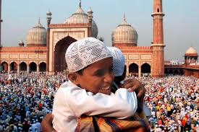
Eid Ul Fitr
The joyous three-day celebration, Eid ul-Fitr falls on the first day of Shawwal, the month which follows Ramadan in the Islamic calendar. However, the celebrations begin upon the sighting of the new moon which marks the end of the month of fasting and prayer.

Slide 54
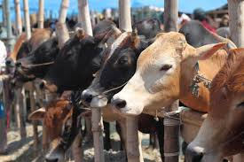
Eid Ul Adha
Eid ul-Adha also known as the Feast of sacrifice falls on the 10th day of the Islamic calendar’s last month, Dhu al-Hijjah. All over the world, Muslims who can afford a cow, goat or sheep sacrifice it as a reminder of Ibrahim’s obedience to Allah.

Slide 55
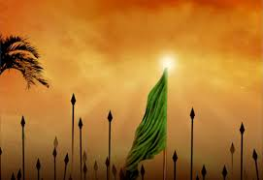
MUHARRAM
Muharram is the first month, which marks the beginning of a new year in Islamic calendar. Muslims all across the world begin the Islamic New Year with the month of Muharram, which started on September 1 this year. In fact, the month of Muharram is considered the second most holy month after Ramzan.

Slide 56

CHIRSTMAS
Christmas, known as "Bara Din" or The Big Day in Bangla is celebrated with festivities in Dhaka and elsewhere in the country. Functions include illumination of churches, decorating Christmas tree & other festivities.

Slide 57
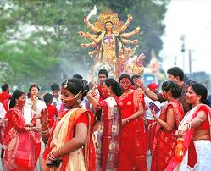
DURGA PUJA
Durga Puja, the biggest festival of the Hindu community in the country, continues for ten days with the last three days being the most joyful. The festivities culminate with the idol of goddess Durga immersed in the river.

Slide 58
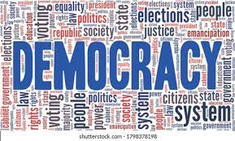
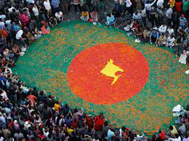

The role of media to promote Democracy in Bangladesh

Slide 59
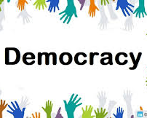
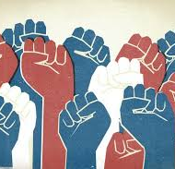
What is Democracy
Democracy means rule by the people. The name is used for different forms of government, where the people can take part in the decisions that affect the way their community is run.
Types of democracy :
Direct democracy.
Representative democracy.
Constitutional democracy.
Monitory democracy.

Slide 60
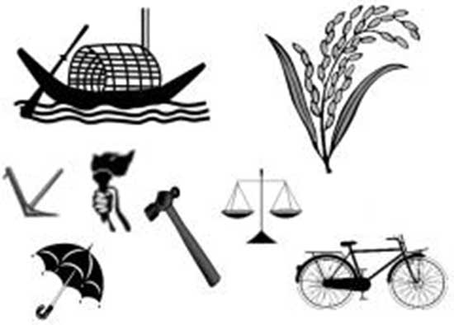

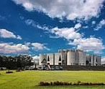
How democracy works :
Politics of Bangladesh takes place in a framework of a parliamentary representative democratic republic, whereby the Prime Minister of Bangladesh is the head of government, and of a multi-party system. Executive power is exercised by the government. Legislative power is vested in both the government and parliament

Slide 61
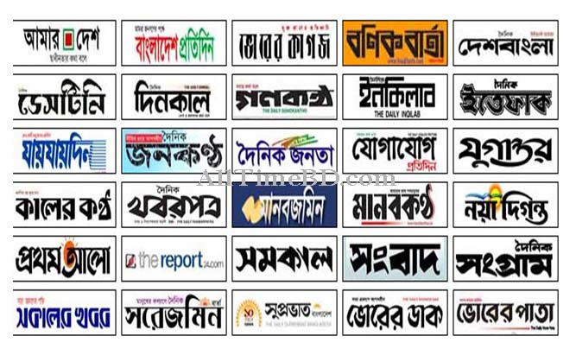
Media in Bangladeshi democracy :
The mass media in Bangladesh refers to the print, broadcast and online mass media available in Bangladesh.
News agencies : News agencies were present in Bangladesh prior to its independence from Pakistan in 1971.
Newspapers : The print media is private and consists of hundreds of weekly publications, presenting a vast array of viewpoints, though some outspoken papers have faced pressure in the past.
Television and radio : Television is the biggest medium for news in Bangladesh. There were 15 television stations in 1999.
Internet media : There are an estimated 11.4 million internet users in Bangladesh.

Slide 62

Importance of media in Bangladeshi democracy :
Media has given political parties the tools to reach large numbers of people and can inform them on key issues ranging from policies to elections. In theory, media should be seen as an enabler for democracy, having better-educated voters would lead to a more legitimate government.

Slide 63
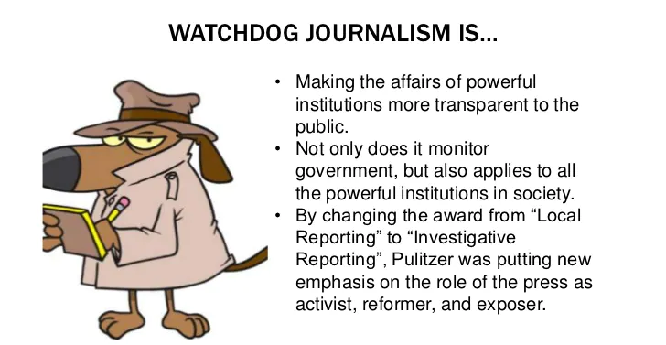
Role of Media in Democracy :
Advances in communication, largely through the internet, have improved community access to information. Therefore, the media play an important role in society as a source of information, but also as a “watchdog” or scrutinizer .

Slide 64
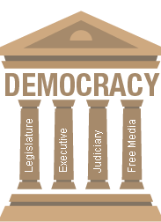
Media is the fourth pillar of democracy :
A media that is free to put forth harsh and genuine realities of the society, independent from all political and religious influences and powerful to make the guilty suffer is proof of effective democracy. The great importance and power of the media make people to consider it the fourth pillar of democracy.

Slide 65
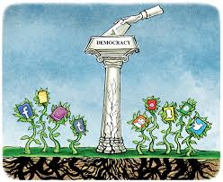
Media affect in a democratic society
Media has given political parties the tools to reach large numbers of people and can inform them on key issues ranging from policies to elections. In theory, media should be seen as an enabler for democracy, having better-educated voters would lead to a more legitimate government.

Slide 66
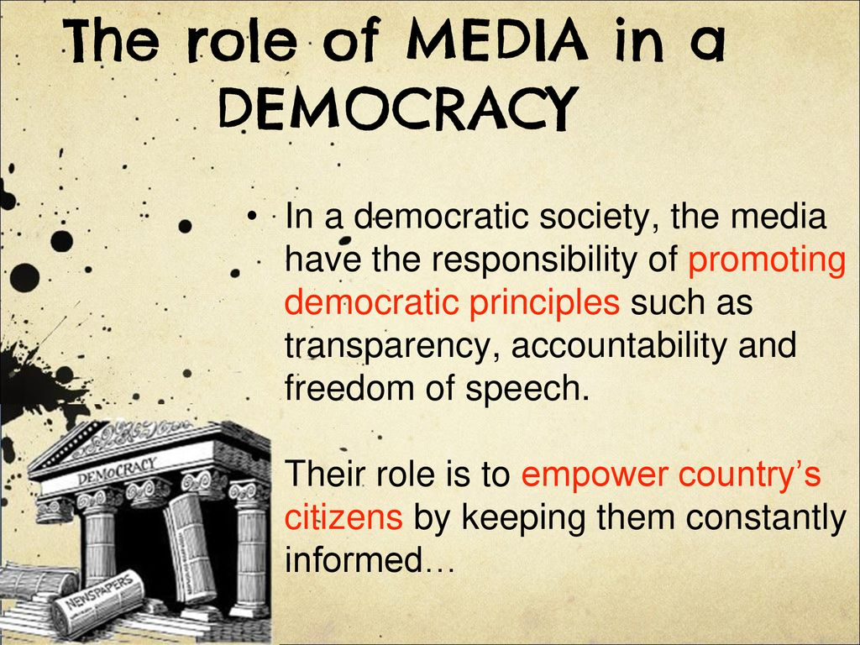
Role of media in democracy :
A free, objective, skilled media is an essential component of any democratic society. On the one hand, it provides the information which the polity require to make responsible, informed decisions.

Slide 67
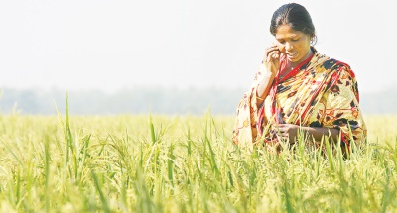
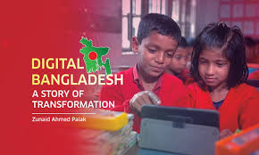

About Digital Bangladesh
Digital Bangladesh is a wonderful vision that is dreamt by the government and the literate class for the technological development of Bangladesh. It is an Idea that includes the IT use for management, administration and governance to ensure transparency, accountability.

Slide 68
Background Of Digital Bangladesh
On the eve of the election, Bangladesh Awami League, one of the major political parties, First declared vision 2021with the aim to turn Bangladesh into a digital country by the next decade. More than a month ago, the Bangladesh Computer Council also organized a computer fair with the theme "Digital Bangladesh". It refers to an e-state where all its activities of governance, commerce, education, agriculture etc will be powered by computer and internet.

Slide 69




Achievement
• Educational sector.
• Social sector.
• Agricultural sector.
• E - Commerce
• ICT sector

Slide 70

Education Sector
• Online Form Fill Up.
• ICT subject mandatory in school.
• Free education up to degree.
• Distributing books among the students at the first day of the year.
• Every School has a mandatory library equipped with necessary books.
• Online Form Fill Up.

Slide 71

Social sector
• Rural development such as safe drinking water, sanitation and education.
• Vocational training institutes across the country produce skilled manpower both for
domestic and overseas employment.
• Women empowerment.
• Child mortality reduced.

Slide 72



Agriculture sector
• Agriculture sector has grown annually at an average growth rate of 3.9 percent during
Awami League tenure.
• In 35 districts, government has arranged to supply tractors, power tillers, harvesters and
other agricultural equipment at 25 percent subsidized price.
• supply seeds and fertilizers to the farmers free of cost. • Introduced krishi call centers.
• Agriculture related information through SMS service
• Agriculture based bangla website.
• Agricultural input assistance

Slide 73

E-Commerce Sector
• Ready Made Garments (RMG).
• Banking sectors (Online Banking).
• Online Shopping.
• Web Hosting, Domain.
• Oil and Gas sector etc.
• Online Transportation System, Hotel Management and Tourism etc.

Slide 74



ICT Sector
Online information center:
• Digital Info Centers in Union and Upazila Parishads.
• Information Portals in all 64 Districts Managed by DCs
• Disaster early warning through mobile network.
Connecting Citizens and Government:
• All 64 DC offices, PMO and Cabinet being connected with video conferencing.
• Community radio being explored.
Internet:
• Affordable bandwidth price.
• 4G service.
Satellite:
• BANGABANDHU-1 Satellite.

Slide 75
Challenges
Lacking Manpower:
• less people to expand the IT sector.
• lack of baseline information.
• lack of vocational training institute.
• lack of opportunities for women.
• Lack of invitation for the youngsters .
• Tendency of moving abroad

Slide 76
Challenges
Lack of professionalism:
• Lack of scope to develop software industry
• Scarcity of skilled team leader /manager
• Lack of eagerness to achieve INT. Recognition
• Lack of knowledge among GOVT. stocks holders
• Immense interest for other Businesses
• Lack of resources and structural limitations.
• Insufficient “EQUAL -CAPITAL DEVELOPMENT FUND”.

Slide 77
Etiquette
Personal interaction is initiated with the greeting Assalam Waleykum ("peace be with you"), to which the required response is, Waleykum Assalam ("and with you").
Hindus, the correct greeting is Nomoshkar, as the hands are brought together under the chin
Men may shake hands if they are of equal status but do not grasp hands firmly.
Men and women do not shake hands with each other.
In same-sex conversation, touching is common and individuals may stand or sit very close.
Leave-taking is sealed with the phrase Khoda Hafez or Allah Hafez.
Individuals with higher status are not addressed by personal name; instead, a title or kinship term is used.
Visitors are always asked to sit, and if no chairs are available, a low stool or a bamboo mat is provided
Open staring is not considered impolite.

Slide 78
Etiquette
Feet are thought to be the ‘dirtiest’ part of the body. The soles of one’s feet should never be pointed at another person, towards a temple or towards a deity. Sit in a way that avoids this.
The top of the head is considered to be the most important part of the human body. To touch someone on the top of their head is considered rude and insensitive. This is especially the case with babies, children, elderly, religious leaders .
To show the utmost respect towards a religious leader or an elder, one will touch the feet of the person.
Never sit higher than an elder. If they are seated on the floor, you should also sit on the floor to avoid being higher than them.
Objects are generally passed with one’s right hand or both hands. The left hand is thought to be reserved for cleaning, and the left hand alone should never be used to pass an object.
Bangladeshis are typically relaxed approach towards timekeeping and punctuality. It is common for people to arrive at events 30 minutes to an hour after the designated time.

Slide 79
Etiquette
Bangladeshis are generally exceptionally hospitable and take great pride in this characteristic
Remove your shoes before entering someone’s home.
It is common to be offered a cup of chai (spiced tea) when visiting someone’s home or occasionally when visiting a shop.
While a gift for the host is not expected, it is generally appreciated. A small token gift, such as chocolates or a gift for the host's children, is usually adequate.
Some sites may also require either females (Muslim mosques) to cover their head.
If you wish to leave someone’s home, it is considered polite and respectful to ask permission to leave .

Slide 80
Religious Beliefs
The symbols and sounds of Islam, such as the call to prayer, punctuate daily life.
Islam is a part of everyday life in all parts of the country, and nearly every village has at least a small mosque and an imam (cleric).
Friday afternoon prayer is often the only time that mosques become crowded.
The imam is associated with a mosque and is an important person in both rural and urban society, leading a group of followers. The imam's power is based on his knowledge of the Koran and memorization of phrases in Arabic.

Slide 81
Eating
Bangladeshis food often does not require utensils to eat. Therefore, there are various forms of eating etiquette relating to the use of one’s hands.
Wash your hands before eating or serving food to an Indian.
Everyone normally uses their right hand to serve themselves, scooping with the fingers or with a serving spoon.
Avoid using your left hand if you are encouraged to eat with your hands. The left hand is considered ‘unclean' since it is the hand people generally use for washing themselves.
Bangladeshi may fill your plate for you, or they may expect you to serve yourself.
We do not consume pork, Alcohol etc.

Slide 82
Gift Giving
Yellow, green and red are considered to be lucky colours and are often used to wrap gifts.
It is advisable for men to say a gift is from both himself and his wife/mother/sister or some other female relative if offering it to a woman. This is to avoid the gift-giving act being interpreted as flirtatious.
Some gifts will be inappropriate depending on one’s religious affiliation. For example, gifts made from leather may offend someone who identifies as Hindu. Gifts relating to pigs, such as pork or pigskin, would be inappropriate to give to someone who identifies as Muslim.

Slide 83
Do’s
Good conversation includes their profession, the well-being of their family and the meaning of their given name.
Treat elders with visible respect. For example, address them first and defer to their opinion. Always sit lower than them and avoid speaking directly or harshly.
Be patient when making decisions or negotiating with Bangladeshi people. We tend to take our time when deliberating decisions, regardless of the urgency or importance of the decision.
Try to dress conservatively and speak respectfully out of respect for Bangladeshi people.
Enjoy a playful and light-hearted sense of humour. We tend to enjoy friendly banter and light teasing.
Try to be conscious of how gender and relationships may impact interactions. For example, some conservative Bangladeshi may find it inappropriate to include a married woman in a conversation if her husband is present.

Slide 84
Don'ts
Avoid crude humour or swearing. Bangladeshis may take offence to this manner of speech quite easily.
Do not directly criticize Bangladesh as a country. This form of criticism from a foreigner is usually unwelcome and may be interpreted as an insult.
Avoid negative comments or criticisms about a person’s ability, appearance or attributes.
Do not criticize or patronize someone for their profession or vocation. Someone’s occupation is usually an important part of one’s personal identity.
Try not to be intimidated by the process of haggling (persistent bargaining over the cost of something). haggling is part of daily life and often an enjoyable process.

Slide 85
Don'ts
Avoid making judgements in absolute terms of right or wrong until you have a clear understanding of the circumstance. For many Bangladeshi, the context and situation are important in understanding whether something is moral and just.
Avoiding discussing tensions between Hindu and Muslim. This is a sensitive or heated topic for some Bangladeshis and can evoke a strong emotional response.

Slide 86


